Slide 1

SERVERLESS
.NET Applications on AWS

Slide 2

AGENDA —
Serverless | . . . . . . . . . . . . . . . . . . . . . . . . . . . . . . . . . . . . . . | 02
AWS Lambda | . . . . . . . . . . . . . . . . . . . . . . . . . . . . . . . . . . . . . . | 07
AWS API Gateway | . . . . . . . . . . . . . . . . . . . . . . . . . . . . . . . . . . . . . . | 18
AWS Cognito | . . . . . . . . . . . . . . . . . . . . . . . . . . . . . . . . . . . . . . | 28
Application Overview | . . . . . . . . . . . . . . . . . . . . . . . . . . . . . . . . . . . . . . | 54
Practice | . . . . . . . . . . . . . . . . . . . . . . . . . . . . . . . . . . . . . . | 56

Slide 3
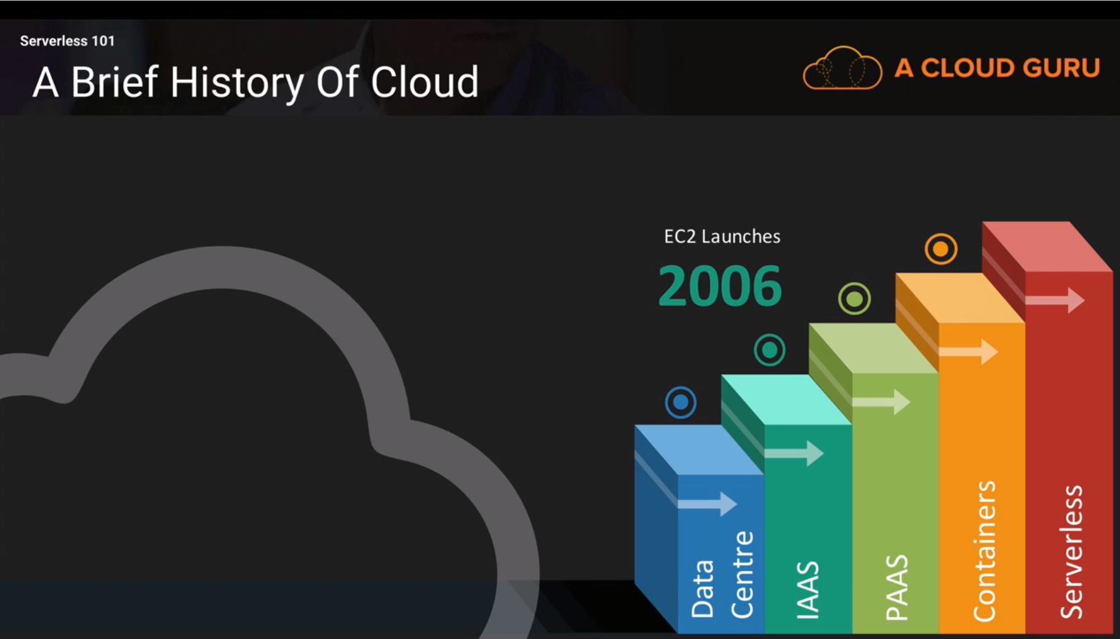
SERVERLESS —

Slide 4
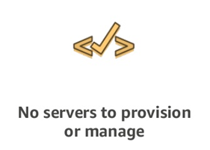
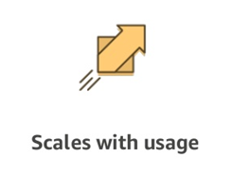
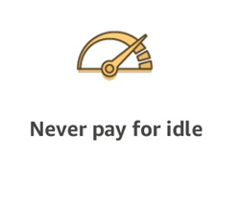
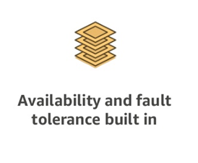
A SERVERLESS WORLD … —

Slide 5
SERVERLESS PROS
SERVERLESS CONS
No server management
Flexible Scaling
Pay for value
High availability
Time to market
“Greener” computing
Vendor control
Complexity
Configuration, deployment
Testing and Debugging

Slide 6
SERVERLESS. AWS Services —
COMPUTE AWS Lambda Lambda@Edge AWS Fargate | STORAGE S3 EFS | DATA STORES DynamoDB Aurora Serverless | ORCHESTRATION Step Functions
MESSAGING SNS SQS | API PROXY API Gateway | ANALYTICS Kinesis Athena | DEVELOPER TOOLING SAM X-Ray, Cloudwatch Codestar Codepipeline Codebuild Codedeploy Cloud9

Slide 7

AWS Lambda —

Slide 8
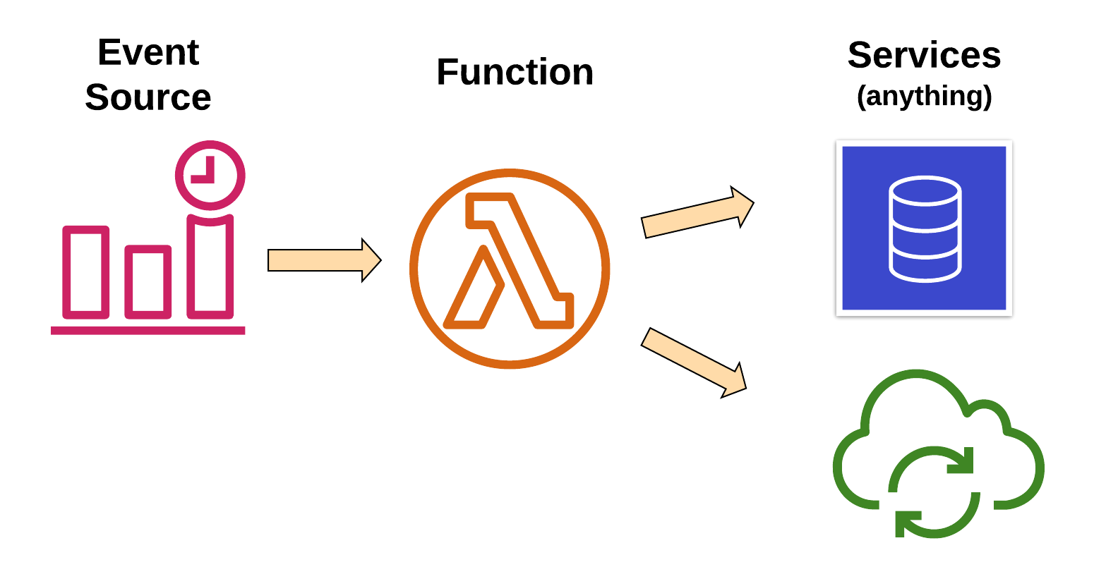
AWS Lambda. Overview —

Slide 9
AWS Lambda. Overview —
Changes in data state
Requests to endpoints
Changes in resource state
Node.js, Python
Java, C#, Go, Ruby
Custom Runtime

Slide 10
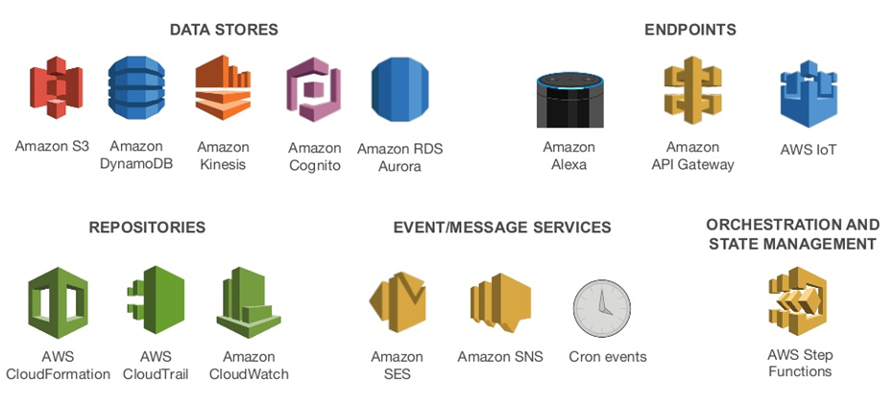
AWS Lambda. Event Sources —

Slide 11
AWS Lambda. Anatomy —
Handler() function
Function to be executed upon invocation
Event object
Data sent during Lambda function invocation
Context object
Methods available to interact with runtime information (request ID, log group, more)
public async Task FunctionHandler(S3Event input, ILambdaContext context)
{
foreach(var record in input.Records)
{
….
}
}

Slide 12
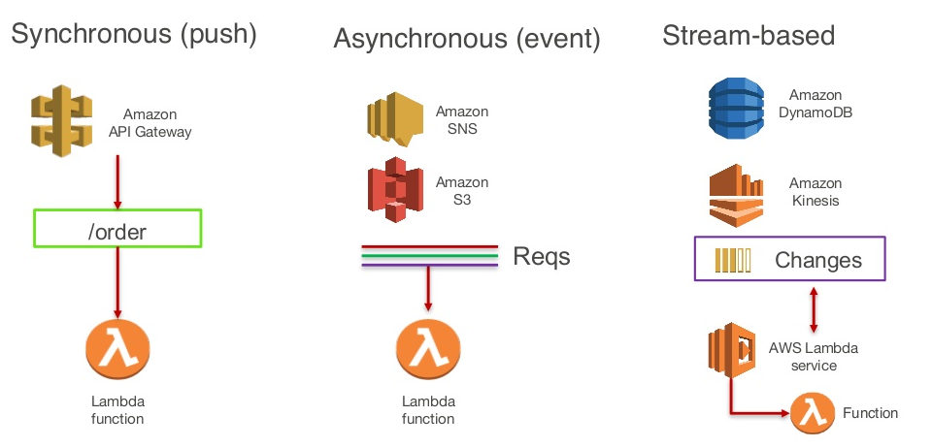
AWS Lambda. Execution Model —

Slide 13






AWS Lambda. Use Cases —
Web Applications
Static websites
Complex web apps
Packages for Flask and Express
Backends
Apps & services
Mobile
IoT
Data Processing
Real time
MapReduce
Batch
Chatbots
Powering chatbot logic
Amazon Alexa
Powering voice-enabled apps
Alexa Skills Kit
IT Automation
Policy engines
Extending AWS services
Infrastructure management

Slide 14
AWS Lambda. Handle —
Load Balancing
Auto Scaling
Handling Failures
Security Isolation
OS Management
Managing Utilization

Slide 15
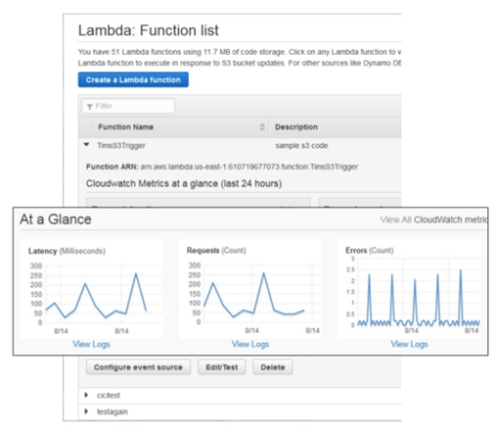
AWS Lambda. Monitoring —
Dashboard for functions
Lists all functions
Easy editing of resources, event sources and other settings
At-a-glance metrics
Metrics reported to CloudWatch
Requests
Errors
Latency
Throttles
Logs captured by CloudWatch Logging service

Slide 16
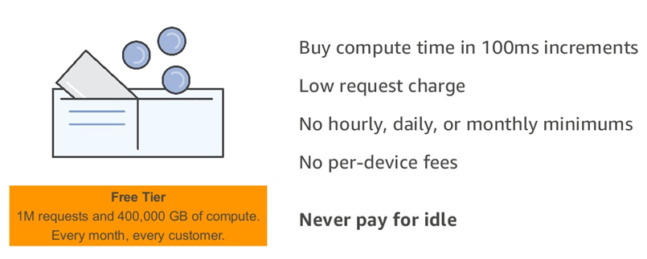
AWS Lambda. Fine-grained Pricing —

Slide 17
AWS Lambda. Limits —
Concurrent executions | 1,000
Function and layer storage | 75 GB
Elastic network interfaces per VPC | 250
Function memory allocation | 128 MB to 3,008 MB, in 64 MB increments.
Function timeout | 900 seconds (15 minutes)
Function environment variables | 4 KB
Function resource-based policy | 20 KB
Function layers | 5 layers
Function burst concurrency | 500 - 3000 (varies per region)
Invocation frequency (requests per second) | 10 x concurrent executions limit (synchronous) 10 x concurrent executions limit (asynchronous – non-AWS sources) Unlimited (asynchronous – AWS service sources)
Invocation payload (request and response) | 6 MB (synchronous) 256 KB (asynchronous)
Deployment package size | 50 MB (zipped, for direct upload) 250 MB (unzipped, including layers) 3 MB (console editor)
Test events (console editor) | 10
/tmp directory storage | 512 MB
File descriptors | 1,024
Execution processes/threads | 1,024

Slide 18

AWS API Gateway —

Slide 19




AWS API Gateway —
Create a unified API frontend for multiple micro-services
DDoS protection and throttling for your backend
Authenticate and authorize requests to a backend
Throttle, meter, and monetize API usage by third-party developers

Slide 20
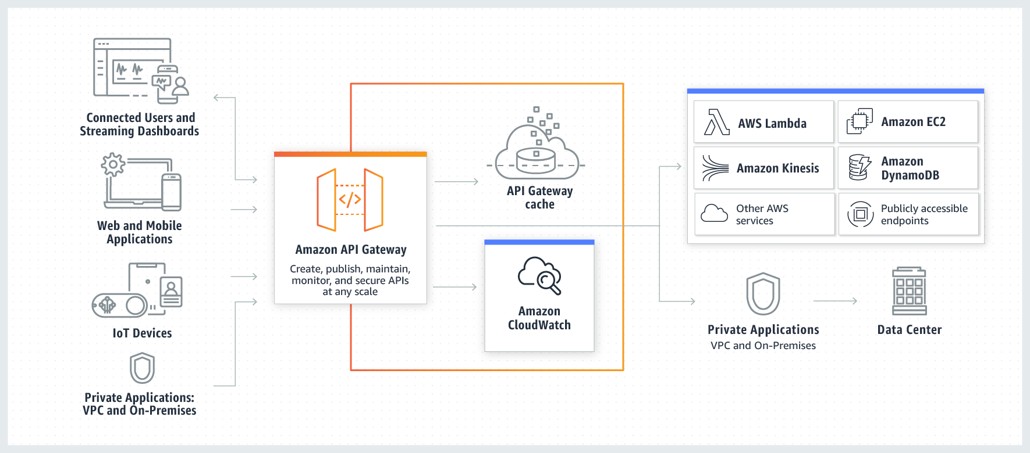
AWS API Gateway. Overview —

Slide 21
AWS API Gateway. Types —
API RESTful
API WEBSOCKET

Slide 22
AWS API Gateway. Features —
Host multiple versions and stages of your APIs
Create and distribute API Keys
Secure API
Throttle and monitor requests to protect your backend
Managed cache to store API responses
Reduced latency and DDoS protection through CloudFront
SDK Generation for iOS, Android and JS
Swagger and Open API support
Request/Response data transformation and API mocking

Slide 23
AWS API Gateway. Deployments —
API Configuration can be deployed to a stage
Stages are different environments
Dev (e.g. awsapigateway.com/dev)
Test (e.g. awsapigateway.com/test)
Stage (e.g. awsapigateway.com/stage)
Prod (e.g. awsapigateway.com/prod)

Slide 24
AWS API Gateway. Meter Usage —
Create API Keys
Combine them into Usage Plans
Set access permissions at the API/Stage level
Meter usage of API Keys through CloudWatch Logs

Slide 25
AWS API Gateway. Transformations —
Use Templates to transform data
Filter output results
Remove private or unnecessary data
Filter dataset size to improve API performance
GET to POST
Read query string parameters from GET request, and create a body to make a POST to backend
JSON to XML
Receive JSON input and transform it to XML for your backend
Receive JSON from a Lambda and transform it to XML

Slide 26
AWS API Gateway. Pricing —
FREE TIER
1M REST API CALLS RECEIVED | 1M HTTP API CALLS RECEIVED | 1M MESSAGES | 750,000 CONNECTION MINUTES
HTTP API Calls
First 300 million - $1
300+ - $0.9
REST API
First 333 million - $3.5
Over 20 billion - $1.51
Caching
58.2 GB - $1 per hour
WEBSOCKET API
First 1 billion - $1 per million
$0.25 per million connection minutes

Slide 27
AWS API Gateway. Limits —
Resource or Operation | Default Quota | Can Be Increased
Routes per API | 300 | Yes
Integrations per API | 300 | No
Maximum integration timeout | 30 seconds | No
Stages per API | 10 | Yes
Tags per stage | 50 | No
Total combined size of request line and header values | 10240 bytes | No
Payload size | 10 MB | No
Custom domains per account per Region | 120 | Yes
Access log template size | 3 KB | No
Amazon CloudWatch Logs log entry | 1 MB | No
Authorizers per API | 10 | Yes
Audiences per authorizer | 50 | No
Scopes per route | 10 | No
Timeout for JSON Web Key Set endpoint | 1500 ms | No
Timeout for OpenID Connect discovery endpoint | 1500 ms | No
VPC links per account per Region | 10 | Yes
Subnets per VPC link | 10 | Yes
Stage variables per stage | 100 | No

Slide 28

AWS Cognito —

Slide 29

AWS Cognito. Overview —
User Identity
Authentication
Authorization
User Management
Sign in users
Federation with enterprise identities
Federation with social identities
Standards-based (Oauth, SAML, OpentID)
Protect data and operations
Provide fine-grained access control
Manage user lifecycles
Store and manage user profile data
Monitor engagement

Slide 30
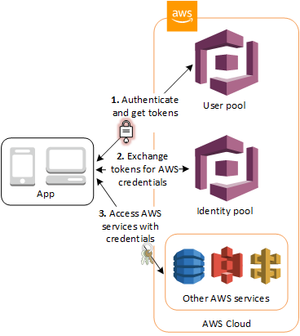
AWS Cognito. Overview —
User Pools
Domain
App Client
Resource Server
Identity Pools
Cognito Sync

Slide 31
AWS Cognito. User Pools —
Sign-up and sign-in services
A built-in, customizable web UI
Social sign-in - Facebook, Google, Amazon, SAML and OIDC.
User directory management and user profiles
Security features - MFA, checks for compromised credentials, account takeover protection, and phone and email verification
Customized workflows and user migration through AWS Lambda triggers

Slide 32
AWS Cognito. Identity Pools —
Amazon Cognito user pools
Access AWS Resources
Social sign-in with Facebook, Google, and Login with Amazon
SAML or OpenID Connect (OIDC) providers
Developer authenticated identities
IAM Roles relation
Cognito Streams
Cognito Events

Slide 33
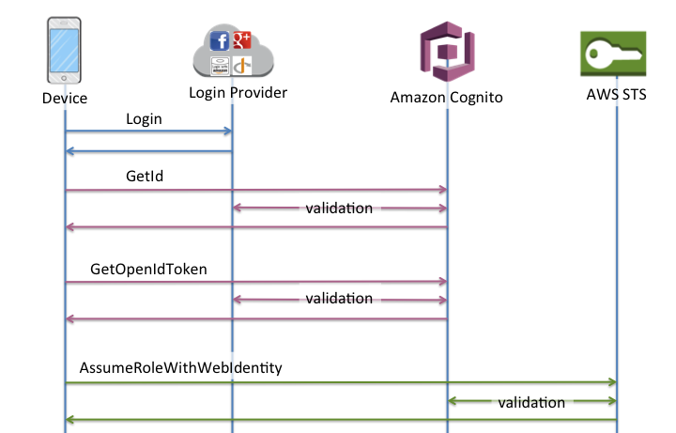
AWS Cognito. Identity Pools —

Slide 34
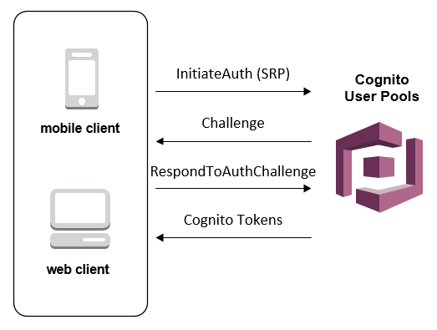
AWS Cognito. Authentication Flows —
Client Side Authentication Flow
Server Side Authentication Flow
Custom Authentication Flow
Admin Authentication Flow
User Migration Authentication Flow

Slide 35
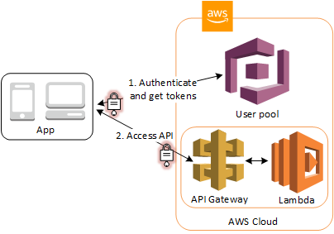
AWS Cognito. Native Support —
API Gateway Authorizers
ALB Authorizers

Slide 36
AWS Cognito. OAuth 2.0 —
OAuth flows
Authorization Code
Implicit
Client credentials
Custom scopes

Slide 37
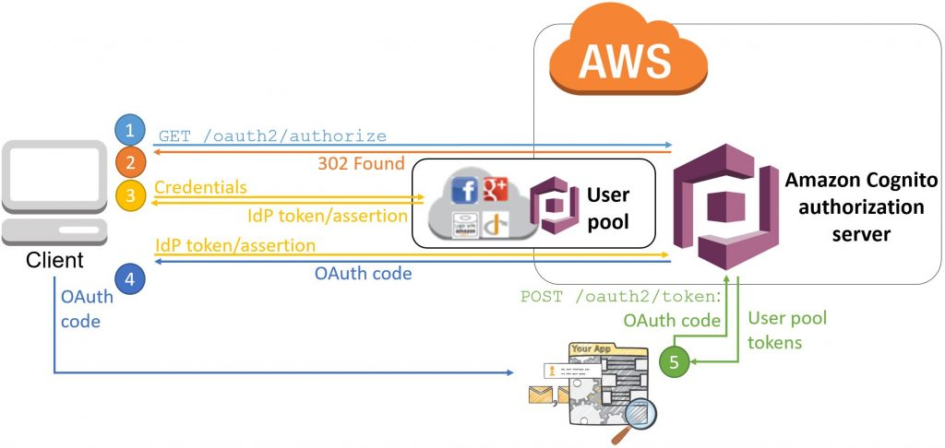
AWS Cognito. OAuth. Authorization Code —

Slide 38
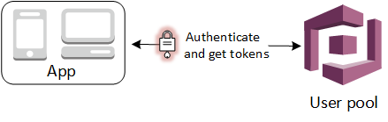
AWS Cognito. OAuth. Tokens —
ID Token contains claims about the identity of the user (name, email, phone_number).
Access Token grants access to authorized resources.
Refresh Token info to get a new ID or access token.

Slide 39
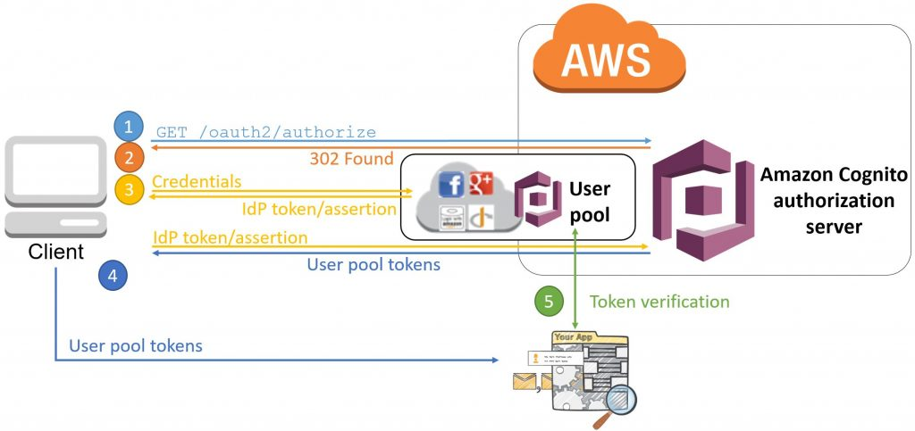
AWS Cognito. OAuth. Implicit —

Slide 40
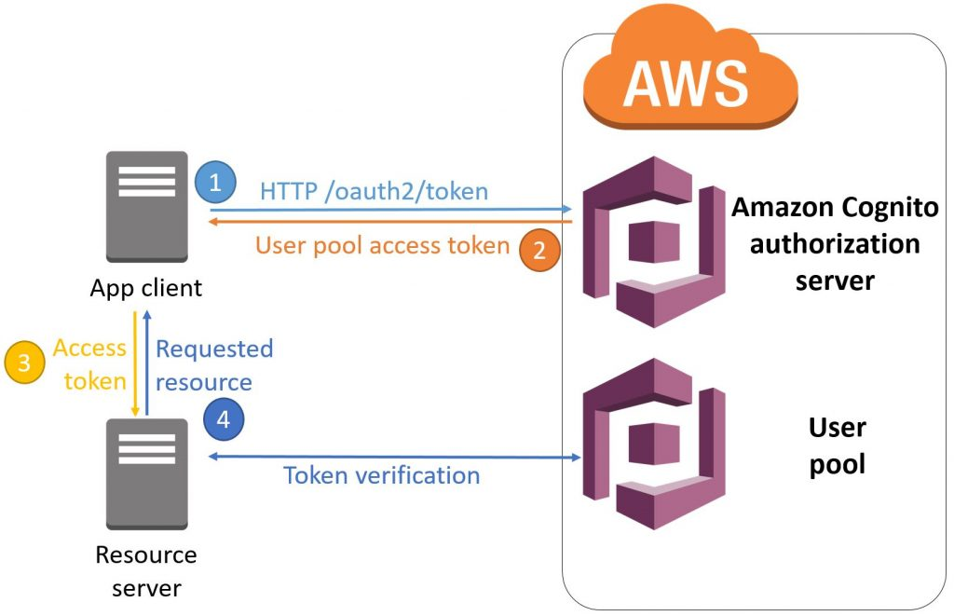
AWS Cognito. OAuth. Client Credentials —

Slide 41
AWS Cognito. Summary —
Serverless Security
Identity Pool is Free
User Pool
Pay per monthly active users (MAUs)
User Data Storage
Pay per sync operations
Pay per sync store

Slide 42

AWS CloudFormation —

Slide 43
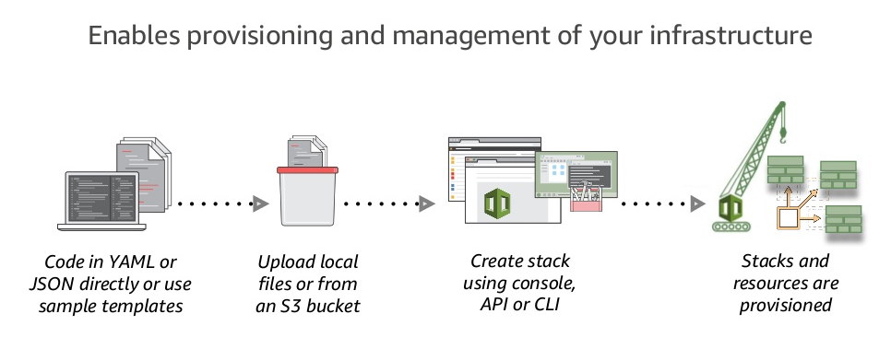
AWS CloudFormation at a Glance —

Slide 44
AWS CloudFormation. Features —
Native AWS Technology
Logical Components Relationship
Visualization
Rollbacks Support
Resources Cleanup
Preview Changes
Costs Trekking
Integration with other AWS Services
Safety Controls
Extensibility

Slide 45
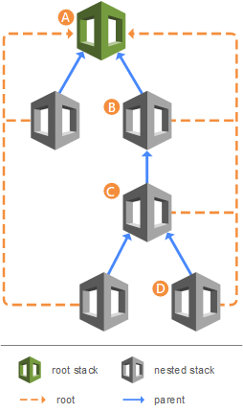
AWS CloudFormation. Stacks —
Create Deployment Stacks
Create Change Sets
Detect Changes
Nested Stacks
Stack Sets
CF CLI

Slide 46
AWS CloudFormation. Benefits and Tools —
Unify Deployment
Detect Changes
CDK
ClaudFormation Macroses
Infrastructure Tests/Validation Pipeline
AWS Serverless Application Repository
Different Deployment Types - Green/Blue, Canary, A/B Testing
AWS Service Catalog

Slide 47

AWS CloudFormation. SAM —
AWS CloudFormation extension or “transform”
Optimized for serverless apps
Serverless resource types: functions, APIs, tables
Support anything AWS CloudFormation support
SAM CLI

Slide 48

AWS CloudFront —

Slide 49
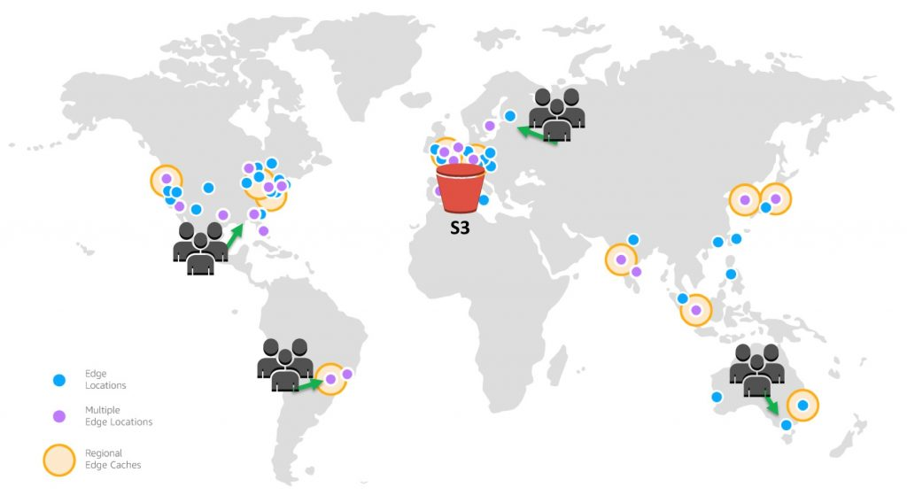
AWS CloudFront —

Slide 50
AWS CloudFront. Features —
Global Amazon Infrastructure
Security
Availability
Performance
Programmable and DevOps Friendly
Lambda@Edge
Cost Effective

Slide 51

AWS CloudWatch —

Slide 52
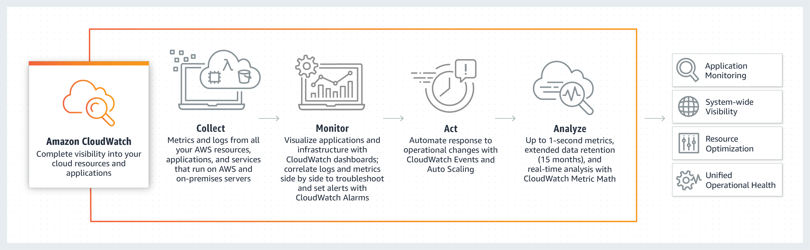
AWS CloudWatch. Overview —

Slide 53
AWS CloudWatch. Features —
Collect
Store logs and Build-in or custom metrics
Monitor
Operational dashboards
High resolution alarms, anomaly detection
Application Insights for .NET and SQL Servers apps
Act
Auto Scaling and CloudWatch Events
Analyze
Compliance and Security

Slide 54
APPLICATION OVERVIEW —
DEMO

Slide 55
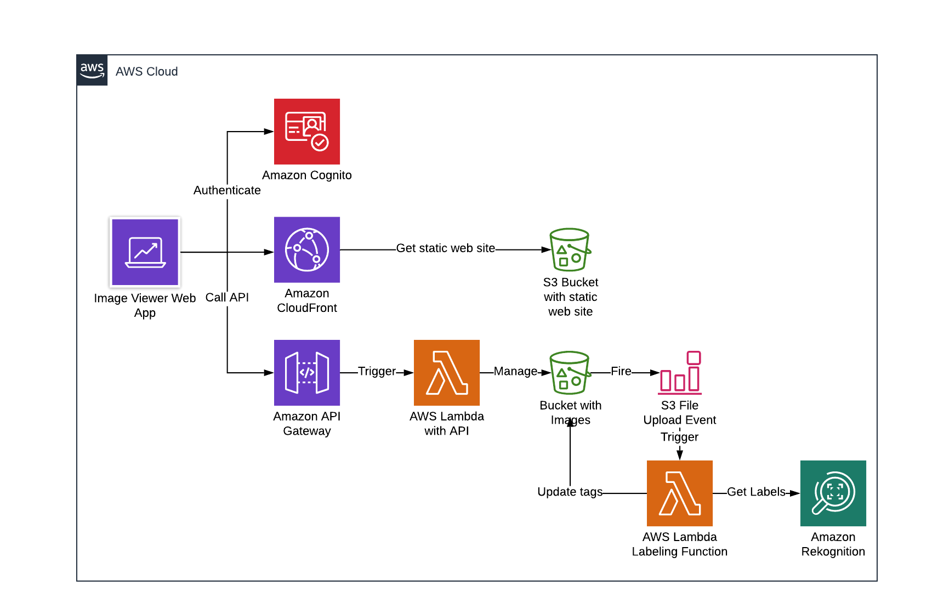
APPLICATION OVERVIEW —

Slide 56
PRACTICE —
https://github.com/illiasaveliev/image-viewer

Slide 57
THANK YOU!

